Slide 1

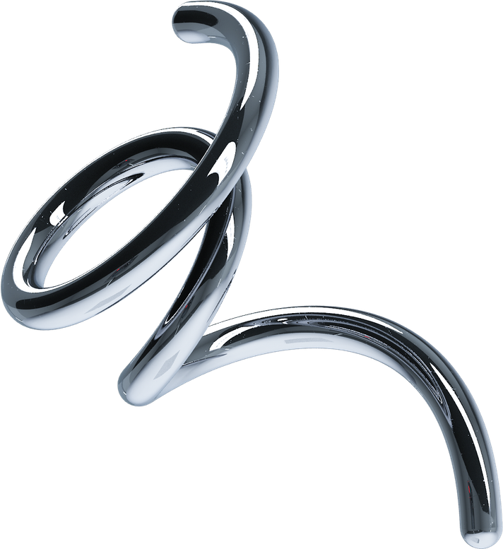
GROUP 5
HOME
ABOUT
CONTENT
OTHERS
Page 01
OPERATING
SYSTEM
Dale Veranrd R. Balila
John Gabriel V. Calderon
Andrei Something Encarnacion

Slide 2
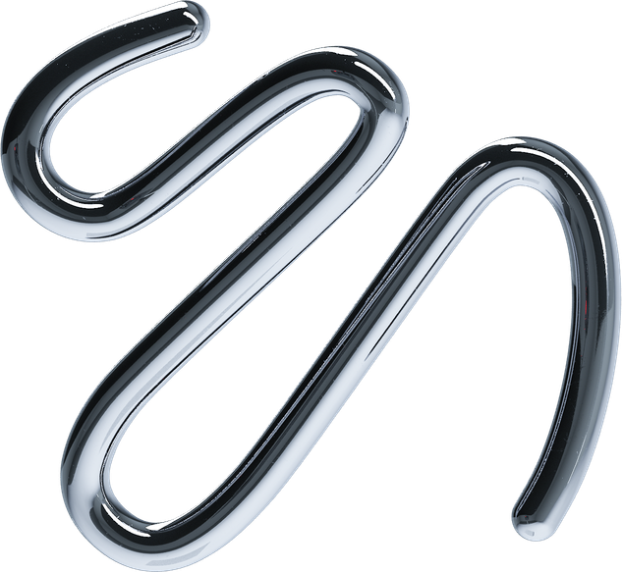
GROUP 5
HOME
ABOUT
CONTENT
OTHERS
Page 02
PROJECT OVERVIEW
Project objectives:
  Implement a full-screen desktop environment.
  Provide a taskbar with three interactive application buttons.
  Create two application screens: Notes and Settings.
  Implement a Task Manager with placeholder CPU and memory usage.
  Provide a real-time clock and a PWR shutdown confirmation.

Slide 3
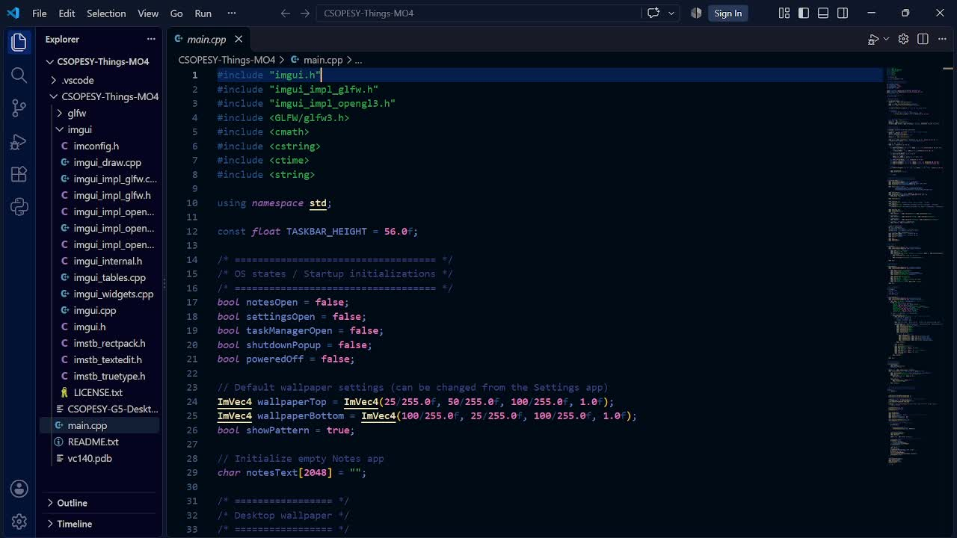
GROUP 5
HOME
ABOUT
CONTENT
OTHERS
Page 03
VIDEO WALKTHROUGH

Slide 4
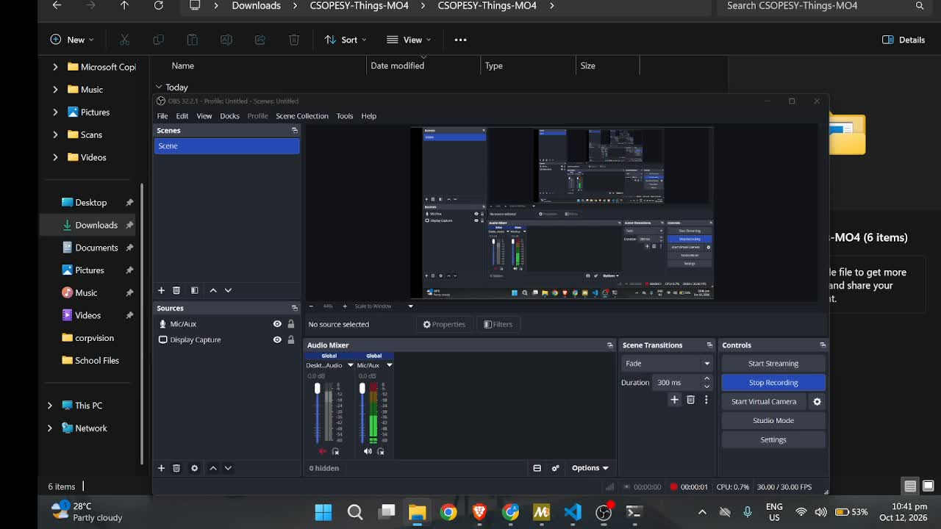
GROUP 5
HOME
ABOUT
CONTENT
OTHERS
Page 03
VIDEO WALKTHROUGH

Slide 5


SYSTEM ARCHITECTURE
Page 04
Main Application (main())
GLFW initialization · ImGui setup · Main loop
Desktop Rendering Layer
Gradient wallpaper · Dot pattern · Desktop title
Taskbar and System Controls
PWR · Notes · Settings · Task Manager · Clock
NOTES
WALLPAPER
TASK MANAGER
Rendering and Display
ImGui draw data → OpenGL rendering → Screen update

Slide 6
GROUP 5
HOME
ABOUT
CONTENT
OTHERS
Page 05
TECHNOLOGIES AND LIBRARIES
C++
DEAR IMGUI
GLFW
OPENGL
  Implements application logic, state management, and the main program loop.
  Creates the user interface
  Creates the application window and manages window events
  Renders the ImGui interface

Slide 7
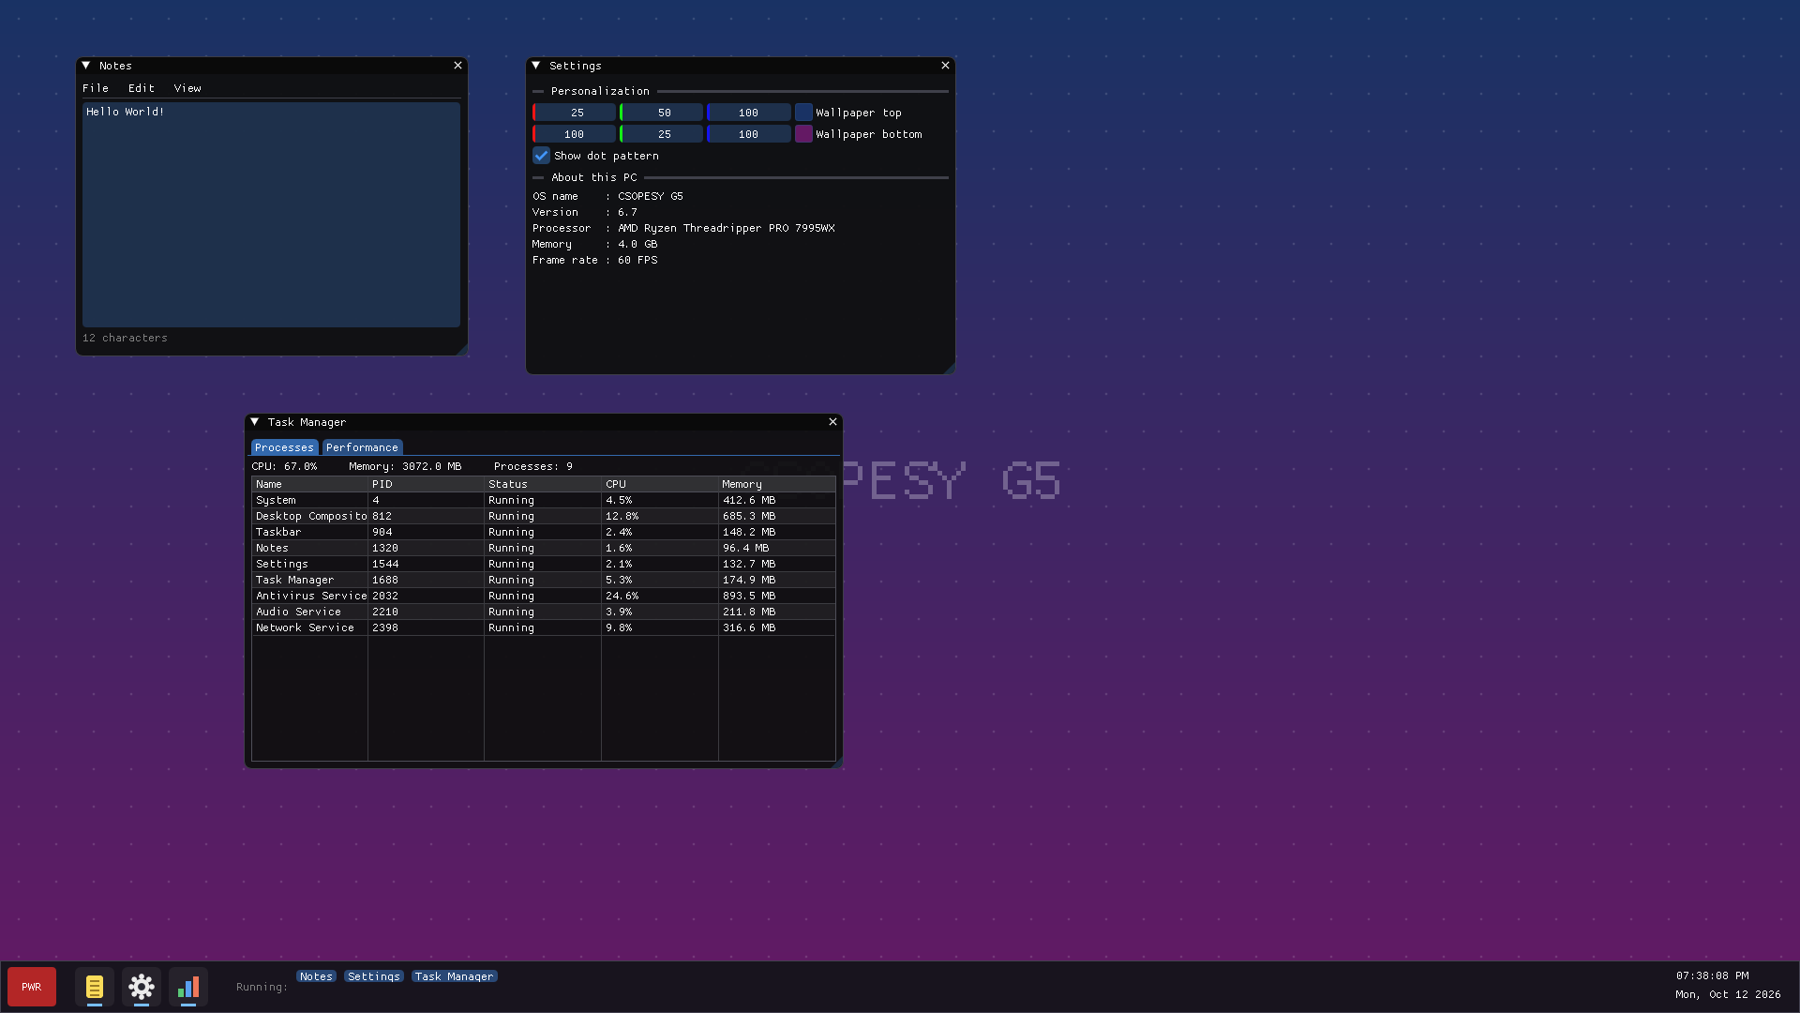

Slide 8
NOTES
  Provides a multiline text input area.
  Allows users to type and edit notes during the session.
  Displays a character count when text is entered.
  Uses an application window that can be opened or closed independently.
void drawNotes(){
ImGui::SetNextWindowPos(ImVec2(80, 60), ImGuiCond_FirstUseEver);
ImGui::SetNextWindowSize(ImVec2(420, 320), ImGuiCond_FirstUseEver);
if (ImGui::Begin("Notes", &notesOpen)){
ImGui::Text("File Edit View");
ImGui::Separator();
ImGui::InputTextMultiline("##notes", notesText, sizeof(notesText), ImVec2(-1, -mGui::GetFrameHeightWithSpacing()));
if (notesText[0] == '\0'){
ImGui::TextDisabled("Start typing your notes here...");
} else {
ImGui::TextDisabled("%d characters", (int)strlen(notesText));
}
}
ImGui::End();
}

Slide 9
SETTINGS
  Allows users to customize the top and bottom wallpaper colors.
  Provides a checkbox to enable or disable the dot pattern.
  Displays system information, including the OS name, version, processor label, memory label, and frame rate.
void drawSettings(){
ImGui::SetNextWindowPos(ImVec2(560, 60), ImGuiCond_FirstUseEver);
ImGui::SetNextWindowSize(ImVec2(460, 340), ImGuiCond_FirstUseEver);
if (ImGui::Begin("Settings", &settingsOpen)){
ImGui::SeparatorText("Personalization");
ImGui::ColorEdit3("Wallpaper top", (float*)&wallpaperTop);
ImGui::ColorEdit3("Wallpaper bottom", (float*)&wallpaperBottom);
ImGui::Checkbox("Show dot pattern", &showPattern);
ImGui::SeparatorText("About this PC");
ImGui::Text("OS name : CSOPESY G5");
ImGui::Text("Version : 6.7");
ImGui::Text("Processor : AMD Ryzen Threadripper PRO 7995WX");
ImGui::Text("Memory : 4.0 GB");
ImGui::Text("Frame rate : %.0f FPS", ImGui::GetIO().Framerate);
}
ImGui::End();
}

Slide 10
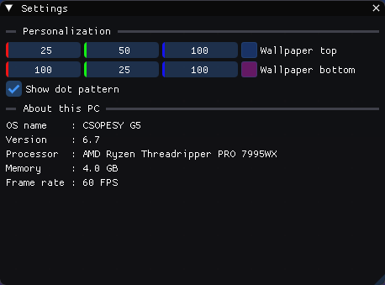
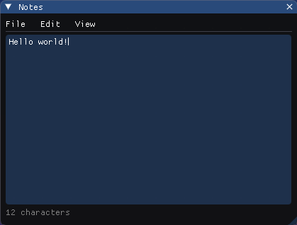
IMPLEMENTATION APPROACH
Boolean state variables control the visibility of each application window. We handle user input, and changes immediately affect the desktop's rendering.

Slide 11
PROCESS TAB
PERFORMANCE TAB
TASK MANAGER
  Process name
  Process ID (PID)
  Process status
  CPU usage in percentage
  Memory usage in megabytes
  CPU utilization progress bar
  Memory utilization progress bar
  Disk utilization progress bar

Slide 12
struct Process { const char* name; int pid; float cpu, memory; const char* status; };
void drawTaskManager(){
if (ImGui::Begin("Task Manager", &taskManagerOpen)){
Process processes[] = { {"System", 4, 4.5f, 412.6f, "Running"}, /*other dummy processes */ };
if (ImGui::BeginTabBar("tabs")){
if (ImGui::BeginTabItem("Processes")){
if (ImGui::BeginTable("processes", 5, ImGuiTableFlags_Borders)){
ImGui::TableSetupColumn("Name");
/* ... PID, Status, CPU, Memory header */
ImGui::TableHeadersRow();
for (Process& p : processes){
ImGui::TableNextRow();
ImGui::TableNextColumn(); ImGui::Text("%s", p.name);
/* ... PID, Status, CPU, Memory dummy values*/
}
ImGui::EndTable();
}
ImGui::EndTabItem();
}
if (ImGui::BeginTabItem("Performance")){ /* CPU / Memory / Disk */ }
ImGui::EndTabBar();
}
}
ImGui::End();
}

Slide 13
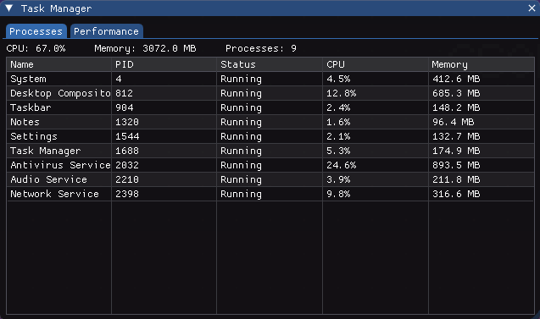
DATA HANDLING
The application uses a predefined array of process records containing dummy CPU and memory values. Moreover, the total CPU usage, total memory usage, and process count are calculated from the array.
It displays a status based on whether the corresponding windows are open.
Limitation: These figures are simulated values for demonstration purposes and do not represent actual operating-system resource usage.

Slide 14

SHUTDOWN AND LIFECYCLE
PWR Button initiates a shutdown confirmation modal rather than closing the OS.
The following events follow:
  A confirmation dialog asks whether to shut down the system.
  Selecting Cancel closes the dialog and returns to the desktop.
  Selecting Shut down sets the poweredOff state to true.
  The main loop ends, and the application releases its rendering resources and terminates GLFW.

Slide 15
void drawShutdownPopup(){
if (shutdownPopup){
ImGui::OpenPopup("Shut down");
shutdownPopup = false;
}
ImVec2 center = ImGui::GetMainViewport()->GetCenter();
ImGui::SetNextWindowPos(center, ImGuiCond_Appearing, ImVec2(0.5f, 0.5f));
if (ImGui::BeginPopupModal("Shut down", nullptr, ImGuiWindowFlags_AlwaysAutoResize)){
ImGui::Text("Are you sure you want to shut down CSOPESY G5?");
ImGui::Spacing();
if (ImGui::Button("Shut down", ImVec2(120, 0))){
poweredOff = true;
}
ImGui::SameLine();
if (ImGui::Button("Cancel", ImVec2(120, 0))){
ImGui::CloseCurrentPopup();
}
ImGui::EndPopup();
}
}

Slide 16
int main(){
if (!glfwInit()){
return 1;
}
// OpenGL 3.0 + GLSL 130
glfwWindowHint(GLFW_CONTEXT_VERSION_MAJOR, 3);
glfwWindowHint(GLFW_CONTEXT_VERSION_MINOR, 0);
// Borderless window (no window control buttons / min-max-close buttons)
GLFWmonitor* monitor = glfwGetPrimaryMonitor();
const GLFWvidmode* mode = glfwGetVideoMode(monitor);
glfwWindowHint(GLFW_DECORATED, GLFW_FALSE);
GLFWwindow* window = glfwCreateWindow(mode->width, mode->height, "CSOPESY G5", nullptr, nullptr);
if (window == nullptr){
return 1;
}
glfwSetWindowPos(window, 0, 0);
glfwMakeContextCurrent(window);
glfwSwapInterval(1); // vsync
// Dear ImGui setup
IMGUI_CHECKVERSION();
ImGui::CreateContext();
ImGui::GetIO().IniFilename = nullptr; // don't save window positions to a file
ImGui::StyleColorsDark();
ImGui::GetStyle().WindowRounding = 8.0f;
ImGui::GetStyle().FrameRounding = 4.0f;
ImGui_ImplGlfw_InitForOpenGL(window, true);
ImGui_ImplOpenGL3_Init("#version 130");
// The OS only stops when the PWR button is used
while (!poweredOff){
glfwPollEvents();
// Block force-exits (Alt+F4)
if (glfwWindowShouldClose(window)){
glfwSetWindowShouldClose(window, GLFW_FALSE);
}
// Start a new frame
ImGui_ImplOpenGL3_NewFrame();
ImGui_ImplGlfw_NewFrame();
ImGui::NewFrame();
ImVec2 screen = ImGui::GetIO().DisplaySize;
// Draw order: desktop first, then taskbar and app windows on top
drawWallpaper(screen);
drawTaskbar(screen);
if (notesOpen) drawNotes();
if (settingsOpen) drawSettings();
if (taskManagerOpen) drawTaskManager();
drawShutdownPopup();
// Render the frame
ImGui::Render();
int width, height;
glfwGetFramebufferSize(window, &width, &height);
glViewport(0, 0, width, height);
glClearColor(0, 0, 0, 1);
glClear(GL_COLOR_BUFFER_BIT);
ImGui_ImplOpenGL3_RenderDrawData(ImGui::GetDrawData());
glfwSwapBuffers(window);
}
// Cleanup
ImGui_ImplOpenGL3_Shutdown();
ImGui_ImplGlfw_Shutdown();
ImGui::DestroyContext();
glfwDestroyWindow(window);
glfwTerminate();
return 0;
}

Slide 17
// The OS only stops when the PWR button is used
while (!poweredOff){
glfwPollEvents();
// Block force-exits (Alt+F4)
if (glfwWindowShouldClose(window)){
glfwSetWindowShouldClose(window, GLFW_FALSE);
}
// Start a new frame
ImGui_ImplOpenGL3_NewFrame();
ImGui_ImplGlfw_NewFrame();
ImGui::NewFrame();
ImVec2 screen = ImGui::GetIO().DisplaySize;
// Draw order: desktop first, then taskbar and app windows on top
drawWallpaper(screen);
drawTaskbar(screen);
if (notesOpen) drawNotes();
if (settingsOpen) drawSettings();
if (taskManagerOpen) drawTaskManager();
drawShutdownPopup();
// Render the frame
ImGui::Render();
int width, height;
glfwGetFramebufferSize(window, &width, &height);
glViewport(0, 0, width, height);
glClearColor(0, 0, 0, 1);
glClear(GL_COLOR_BUFFER_BIT);
ImGui_ImplOpenGL3_RenderDrawData(ImGui::GetDrawData());
glfwSwapBuffers(window);
}
// Cleanup
ImGui_ImplOpenGL3_Shutdown();
ImGui_ImplGlfw_Shutdown();
ImGui::DestroyContext();
glfwDestroyWindow(window);
glfwTerminate();
return 0;
}

Slide 18
// Cleanup
ImGui_ImplOpenGL3_Shutdown();
ImGui_ImplGlfw_Shutdown();
ImGui::DestroyContext();
glfwDestroyWindow(window);
glfwTerminate();
return 0;
}

Slide 19

IMPLEMENTATION APPROACH
  Main application loop: The program continuously processes events, updates the interface, draws the desktop and open applications, and renders each frame until the poweredOff variable becomes true.
  Shutdown request: Clicking the PWR button sets shutdownPopup to true, opening a confirmation dialog.
  User confirmation: Selecting Shut down sets poweredOff to true, while selecting Cancel closes the dialog without terminating the application.
  Application termination: When the main loop ends, the program shuts down the ImGui rendering backends, destroys the ImGui context, destroys the GLFW window, and terminates GLFW.

Slide 20
DESIGN DISCUSSION
  Interface Design: We developed the interface using C++, Dear ImGui, GLFW, and OpenGL to create a borderless, full-screen desktop with a customizable wallpaper and taskbar.
  Extra Application Features: We decided to include Notes for text editing and Settings for wallpaper customization since we wanted to explore more and more.
  Interaction and State Management: We used Boolean variables to control application windows and respond to user actions.
  Application Lifecycle: Initializes the graphical interface, continuously renders the desktop through a main loop, and cleans up resources when the application exits.
  Shutdown Mechanism: The PWR button opens a confirmation dialog. Confirming shutdown ends the main loop and terminates the desktop simulation.

Slide 21
THANK YOU
-

